Slide 1

CSCI 466: Networks
Subnets, NAT, IPv6, SDN
Reese Pearsall Fall 2023
https://www.cs.montana.edu/pearsall/classes/fall2023/466/main.html
*All images are stolen from the internet
1

Slide 2
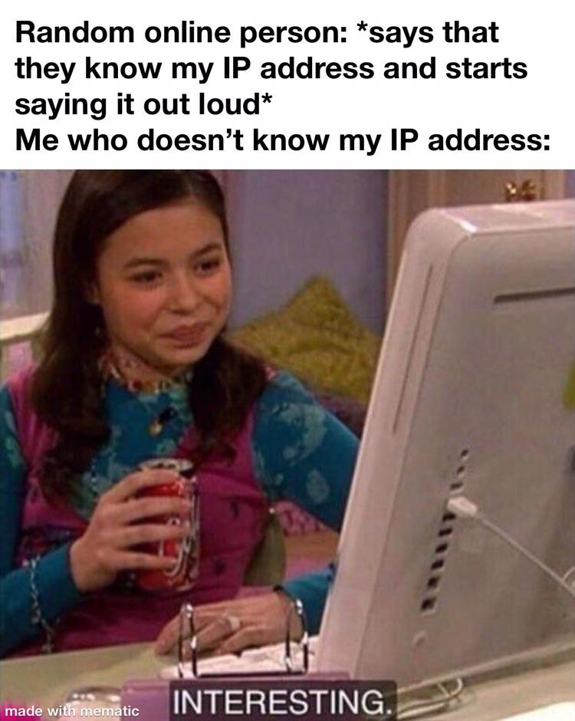
Announcements
PA2 due Friday (10/20)
Final Ack cannot be corrupted
Friday will be a work day for PA2 (no lecture)

Slide 3

Application Layer
Presentation Layer
*
Application Layer
Session Layer
*
Messages from Network Applications
Transport Layer
Network Layer
Physical Layer
Data Link Layer
Bits being transmitted over a medium
Physical Layer
*In the textbook, they condense it to a 5-layer model,
but 7 layers is what is most used

Slide 4

Application Layer
Presentation Layer
*
Application Layer
Session Layer
*
Messages from Network Applications
Transport Layer
Network Layer
Physical Layer
Data Link Layer
Bits being transmitted over a medium
Physical Layer
*In the textbook, they condense it to a 5-layer model,
but 7 layers is what is most used

Slide 5
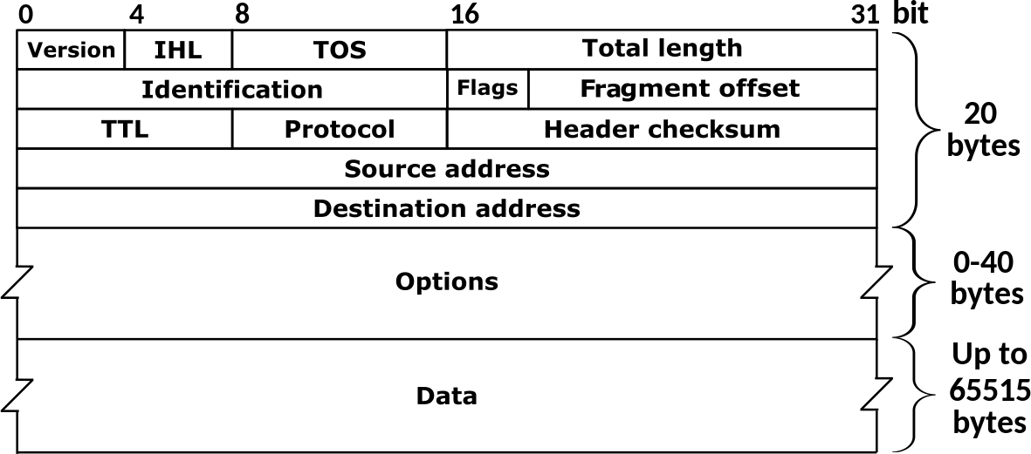
IPv4: 32-bit addresses (decimal)
Packets traversing through the network layer are referred to as a datagram. Each packet gets an IPv4/IPv6 header
192.149.252.76
IPv6: 64-bit addresses (hexademical)
3ffe:1900:fe21:4545::
Transport Layer Header
IP Header
Application Layer Message
Transport
Layer Header
Message
Why do we need IPv6?
IPv4 Header

Slide 6
IP Address: Globally unique* 32 bit (4 byte) dotted decimal number assigned to interfaces on hosts and routers
Used to identify a host on a network
(1 byte = 8 bits)
193.32.216.9
=
11000001 00100000 11011000 00001001
How many addresses are possible with a 32 bit number? ~4 billion possible IPv4 addresses

Slide 7
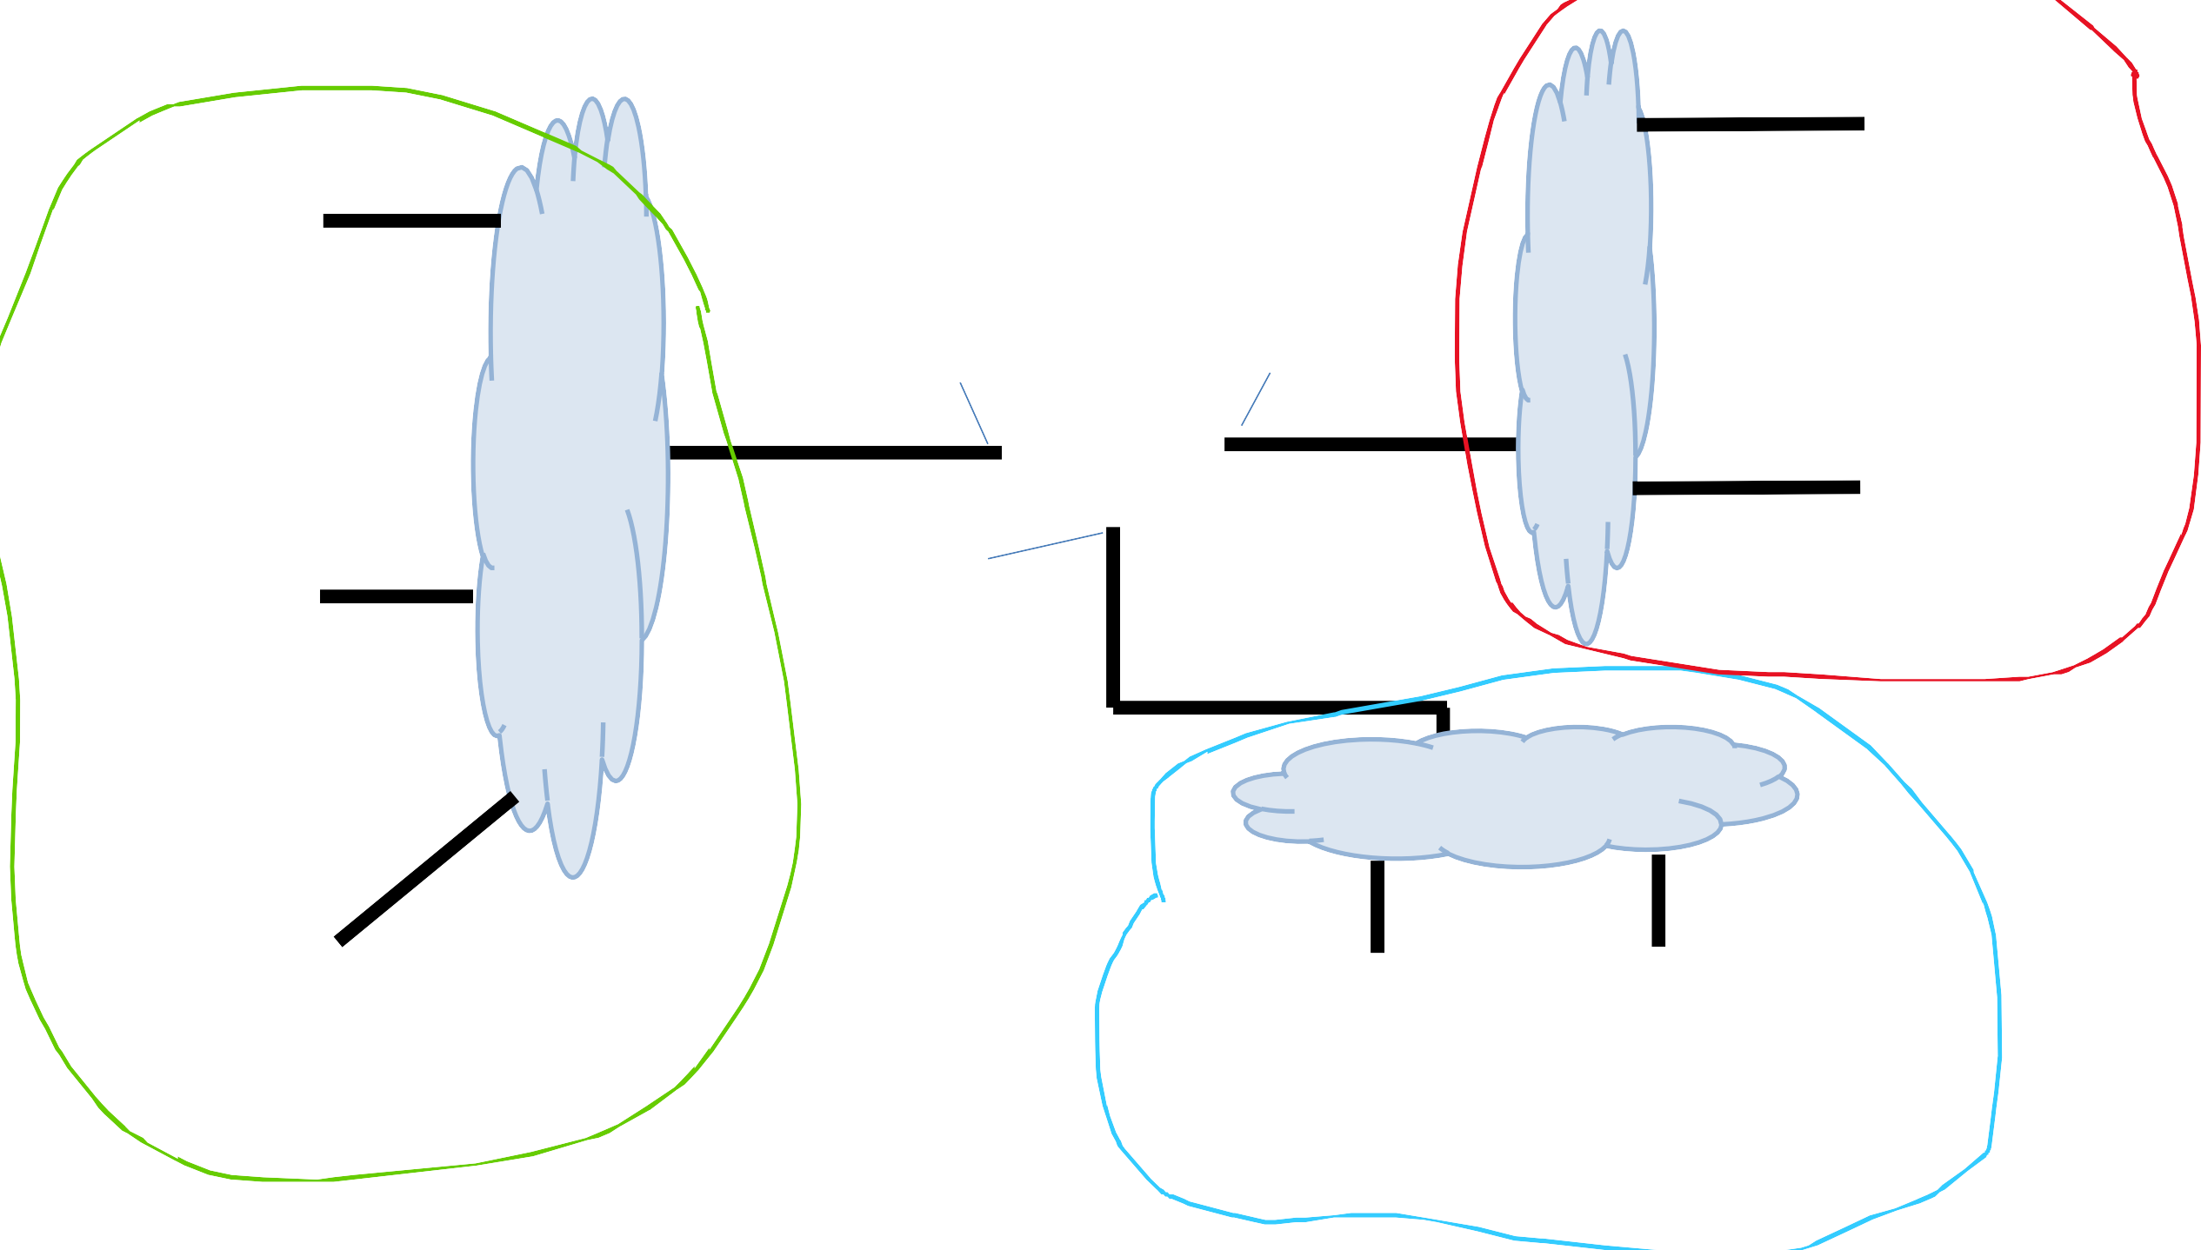
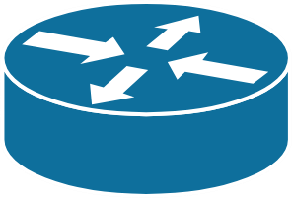
223.1.2.1
Subnet is a logical subdivision of an IP network In this network, we have 3 subnets
223.1.1.1
223.1.1.4
223.1.2.9
223.1.2.2
223.1.3.27
223.1.1.2
223.1.1.3
223.1.3.1
223.1.3.2

Slide 8

It is very common to have a range of IP addresses assigned to you (random assignment would be chaos)
Subnet mask
223.1.1.0/24
The leftmost 24 bits represent the prefix of the subnet
11111111 11111111 11111111 XXXXXXXX = 255.255.255.0
223.1.1.1
223.1.1.67
223.2.1.67
223.2.1.255
223.1.1.2
…
193.32.216.9
Network bits
Host bits
223.1.1.253
11000001 00100000 11011000 00001001

Slide 9
A subnet mask can be used to reveal which bits are the host bits

Slide 10
A subnet mask can be used to reveal which bits are the host bits
172.16.1.0
10101100.00010000.00000001.00000000
255.255.0.0
11111111.11111111.00000000.00000000

Slide 11
A subnet mask can be used to reveal which bits are the host bits
172.16.1.0
10101100.00010000.00000001.00000000
255.255.0.0
11111111.11111111.00000000.00000000

Slide 12
A subnet mask can be used to reveal which bits are the host bits
172.16.1.0
10101100.00010000.00000001.00000000
255.255.0.0
11111111.11111111.00000000.00000000
The last two octets do not match 1s, so they are the host bits

Slide 13
A subnet mask can be used to reveal which bits are the host bits
172.16.1.0
10101100.00010000.00000001.00000000
255.255.0.0
11111111.11111111.00000000.00000000
The last two octets do not match 1s, so they are the host bits
This IP address would fall under the range of:
172.16.0.0 /16

Slide 14
A subnet mask can be used to reveal which bits are the host bits
172.16.1.0
10101100.00010000.00000001.00000000
255.255.224.0
11111111.11111111.11100000.00000000

Slide 15
A subnet mask can be used to reveal which bits are the host bits
172.16.1.0
10101100.00010000.00000001.00000000
255.255.224.0
11111111.11111111.11100000.00000000
The last 13 bits are the host bits, the first 19 bits are the network bits

Slide 16
A subnet mask can be used to reveal which bits are the host bits
172.16.1.0
10101100.00010000.00000001.00000000
255.255.224.0
11111111.11111111.11100000.00000000
The last 13 bits are the host bits, the first 19 bits are the network bits
This IP address would fall under the range of
172.16.0.0/19
CIDR

Slide 17
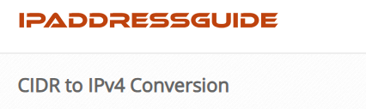
A subnet mask can be used to reveal which bits are the host bits
172.16.1.0
10101100.00010000.00000001.00000000
255.255.224.0
11111111.11111111.11100000.00000000
The last 13 bits are the host bits, the first 19 bits are the network bits
This IP address would fall under the range of
172.16.0.0/19
CIDR

Slide 18
A subnet mask can be used to reveal which bits are the host bits
CIDR
172.0.0.0/9
Subnet Mask?

Slide 19
A subnet mask can be used to reveal which bits are the host bits
CIDR
172.0.0.0/9
Subnet Mask?
11111111.10000000.00000000.00000000

Slide 20
A subnet mask can be used to reveal which bits are the host bits
CIDR
172.0.0.0/9
Subnet Mask?
11111111.10000000.00000000.00000000
255.128.0.0

Slide 21

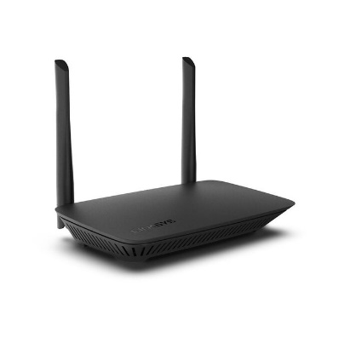


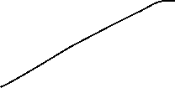




















One Subnet

Slide 22



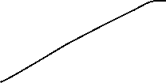























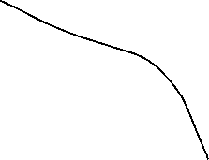


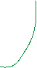




When communicating on a subnet, the message gets broadcasted to every device on the network

Slide 23






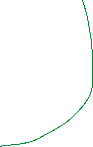




If there are many devices on a subnet, then this might cause some problems (congestion, lag, delay)

Slide 24


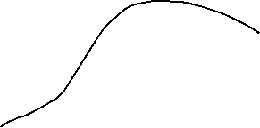


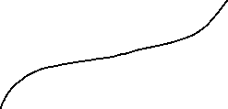
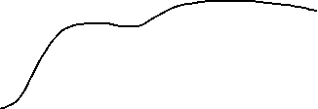

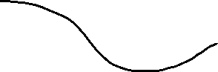


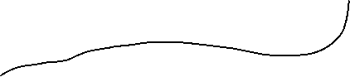

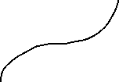






Six Subnets

Slide 25

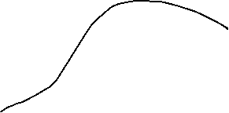


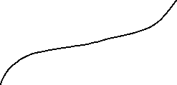
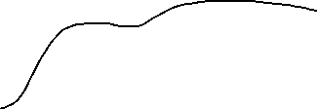





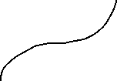








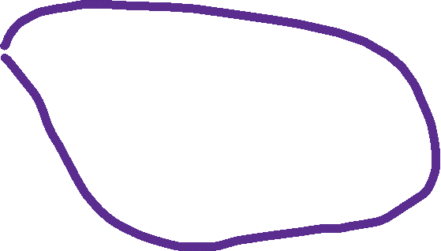
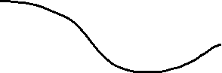
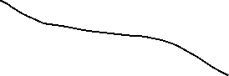
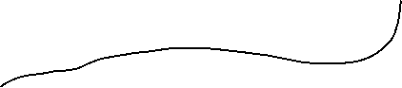

Six Subnets

Slide 26
Suppose that a packet needs to be sent to another subnet

Slide 27









We broadcast to our subnet, but we won’t find our destination

Slide 28
So, the packet will get sent to the default gateway, which is typically the router

Slide 29



And the router will send it the correct subnet

Slide 30
Subnets
Suppose we have a class c network
X.X.X.0/24
Subnet Mask
11111111.11111111.11111111.00000000

Slide 31
Subnets
Suppose we have a class c network
X.X.X.0/24
Subnet Mask
11111111.11111111.11111111.00000000
1 network with 253* hosts
What if we wanted to divide this network into multiple subnets?

Slide 32
Subnets
Suppose we have a class c network
X.X.X.0/24
Subnet Mask
11111111.11111111.11111111.00000000
1 network with 253* hosts
What if we wanted to divide this network into multiple subnets?
We sacrifice one of our host bits, and give it to the network bits

Slide 33
Subnets
Suppose we have a class c network
X.X.X.0/24
Subnet Mask
11111111.11111111.11111111.00000000
1 network with 253* hosts
What if we wanted to divide this network into multiple subnets?
We sacrifice one of our host bits, and give it to the network bits
Subnet 1:
11111111.11111111.11111111.00000000
Subnet 2:
11111111.11111111.11111111.10000000
2 Networks with 126 hosts

Slide 34
Subnets
Suppose we have a class c network
X.X.X.0/24
Subnet Mask
11111111.11111111.11111111.00000000
1 network with 253* hosts
What if we wanted to divide this network into multiple subnets?
We sacrifice one of our host bits, and give it to the network bits
Subnet 1:
11111111.11111111.11111111.00000000
Subnet 2:
11111111.11111111.11111111.10000000
Subnet 3:
11111111.11111111.11111111.01000000
Subnet 4:
11111111.11111111.11111111.11000000
4 Networks with 62 hosts

Slide 35
Subnets
Suppose we have a class c network
X.X.X.0/24
Subnet Mask
11111111.11111111.11111111.00000000
1 network with 253* hosts
What if we wanted to divide this network into four subnets?
We sacrifice one of our host bits, and give it to the network bits
Subnet 1:
11111111.11111111.11111111.00000000
Subnet 2:
11111111.11111111.11111111.10000000
Subnet 3:
11111111.11111111.11111111.01000000
Subnet 4:
11111111.11111111.11111111.11000000
4 Networks with 62 hosts

Slide 36
Subnets
Suppose we have a class c network
X.X.X.0/24
Subnet Mask
11111111.11111111.11111111.00000000
1 network with 253* hosts
What if we wanted to divide this network into four subnets?
We sacrifice one of our host bits, and give it to the network bits
New Subnet Mask
11111111.11111111.11111111.11000000
255.255.255.192

Slide 37
Issue: IPv4 can only support ~4 billion devices
If every device on the internet gets an IP address, we are going to run out of IP addresses to use

Slide 38
Issue: IPv4 can only support ~4 billion devices
If every device on the internet gets an IP address, we are going to run out of IP addresses to use
Solution: IPv6 (This will take awhile to implement and switch to)
Temporary Solution: Public IP addresses, Private IP addresses, NAT

Slide 39




Every device needs an IP address of some kind…
The Internet

Slide 40




Every device needs an IP address of some kind…
We could give every device a public IP address (public registered), but this would be expensive, and a waste of IPv4 addresses
The Internet

Slide 41
Every device needs an IP address of some kind…
We could give every device a public IP address (public registered), but this would be expensive, and a waste of IPv4 addresses
Your ISP will assign your router/modem a public IP address
The Internet
12.234.56.78

Slide 42
Your router will assign private IP addresses to each device via DHCP
Private IP addresses are only used internally, they are not seen by the “outside world”
Private IP addresses typically have a common prefix
192.168.0.1
The Internet
192.168.0.2
12.234.56.78
10.x.x.x
172.x.x.x
192.168.x.x
192.168.0.3

Slide 43
Issue: When receiving a packet with our public IP address, we need to convert to our private IP address to ensure it gets delivered to the correct host
(and vice versa)
192.168.0.1
The Internet
DST: 12.234.56.78
192.168.0.2
12.234.56.78
192.168.0.3

Slide 44
NAT (network address translation) is what translates a set of IP addresses to another set of IP addresses (Public ←→ Private)
192.168.0.1
The Internet
192.168.0.2
12.234.56.78
192.168.0.3

Slide 45


NAT (network address translation) is what translates a set of IP addresses to another set of IP addresses (Public ←→ Private)
DST: 192.168.0.1
192.168.0.1
The Internet
NAT
DST: 12.234.56.78
192.168.0.2
12.234.56.78
192.168.0.3

Slide 46
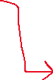
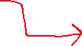
NAT (network address translation) is what translates a set of IP addresses to another set of IP addresses (Public ←→ Private)
SRC: 192.168.0.1
192.168.0.1
The Internet
NAT
SRC: 12.234.56.78
192.168.0.2
12.234.56.78
192.168.0.3

Slide 47







Because private IP addresses are only used internally within a subnet, devices on the internet can have the same private IP address (which is fine!)
192.168.0.1
The Internet
192.168.0.2
12.234.56.78
192.168.0.3
56.131.23.89
Devices on the same subnet should not have same private IP addresses
192.168.0.6
192.168.0.1
192.168.0.5

Slide 48




The Internet
12.234.56.78
192.168.0.1
192.168.0.2
192.168.0.3
192.168.0.4
192.168.0.5

Slide 49




The Internet
12.234.56.78
192.168.0.1
192.168.0.2
Suppose a host is doing something malicious on some website
192.168.0.3
The website might decide to block their IP address
192.168.0.4
192.168.0.5

Slide 50
The Internet
12.234.56.78
192.168.0.1
192.168.0.2
Suppose a host is doing something malicious on some website
192.168.0.3
The website might decide to block their IP address
However, from their perspective, their IP address is 12.234.56.78
192.168.0.4
192.168.0.5

Slide 51
The Internet
12.234.56.78
192.168.0.1
192.168.0.2
Suppose a host is doing something malicious on some website
192.168.0.3
The website might decide to block their IP address
However, from their perspective, their IP address is 12.234.56.78
So, they block the IP address 12.234.56.78
192.168.0.4
192.168.0.5

Slide 52

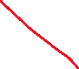
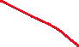
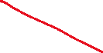

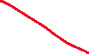




The Internet
12.234.56.78
192.168.0.1
192.168.0.2
Suppose a host is doing something malicious on some website
192.168.0.3
The website might decide to block their IP address
However, from their perspective, their IP address is 12.234.56.78
So, they block the IP address 12.234.56.78
Because this public IP address is shared by several hosts, all the other hosts also get blocked
192.168.0.4
192.168.0.5

Slide 53
How to see your private and public IP address

Slide 54
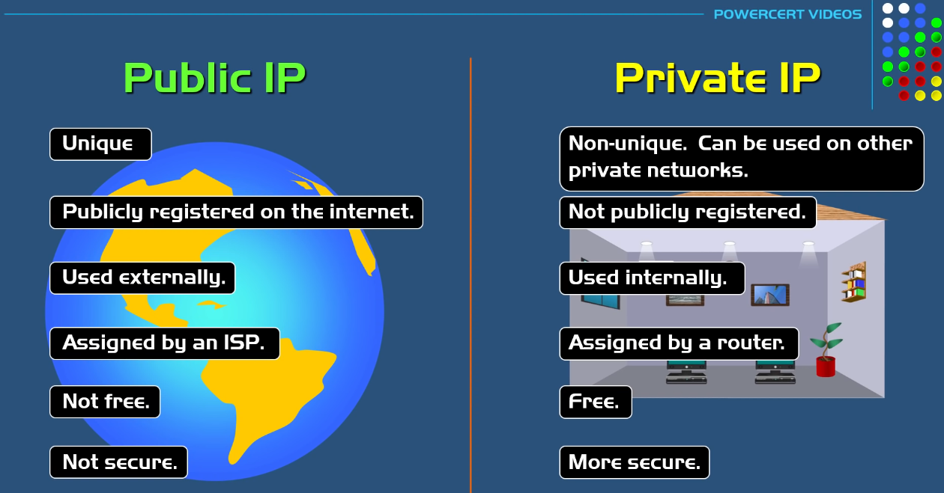

Slide 55
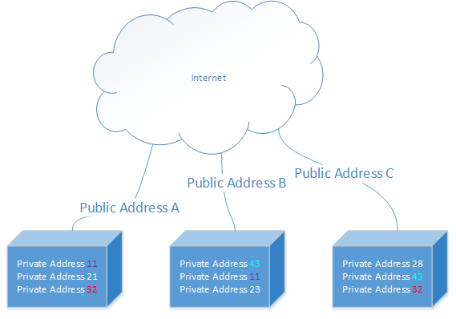

Slide 56
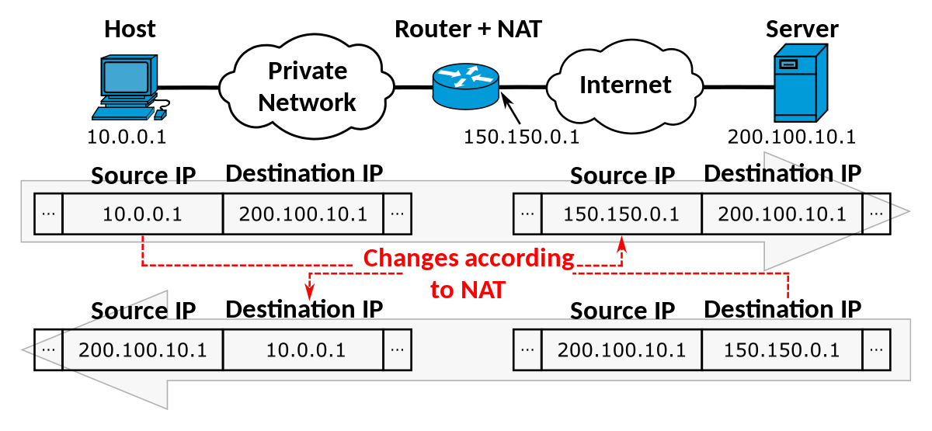

Slide 57
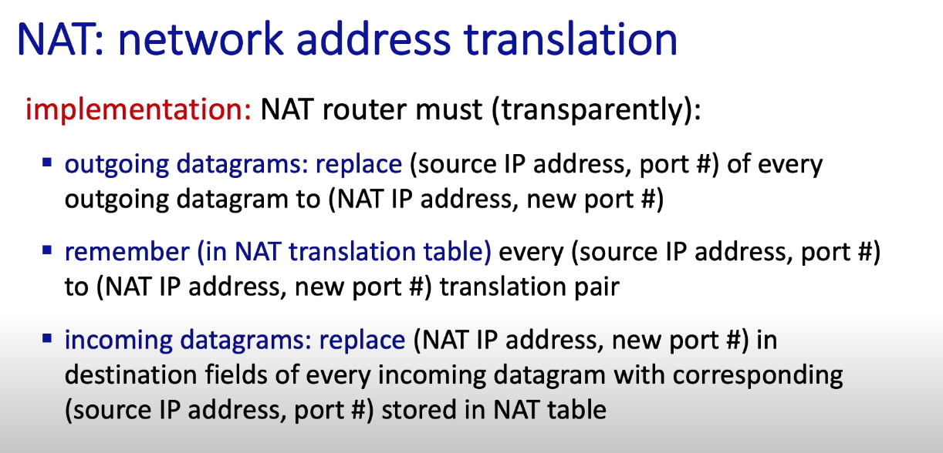

Slide 58
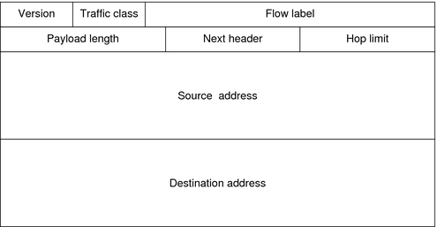
Packets traversing through the network layer are referred to as a datagram. Each packet gets an IPv4/IPv6 header
Transport Layer Header
IP Header
Message
Transport
Layer Header
TCP header = 20 bytes IP header = 20 bytes
Message
IPv6 = 128 bits
IPv6 Header
(128 bits)
(128 bits)
The goal is for our internet to be only using IPv6 in the near future? Issues?

Slide 59
Issue: some routers use IPv4, some use IPv6, some use both. How do we get all networking equipment to coexist with each other?
IPv6
IPv4
IPv6
Solution:

Slide 60
Issue: some routers use IPv4, some use IPv6, some use both. How do we get all networking equipment to coexist with each other?
IPv6
IPv4
IPv6
Solution: Tunneling

Slide 61
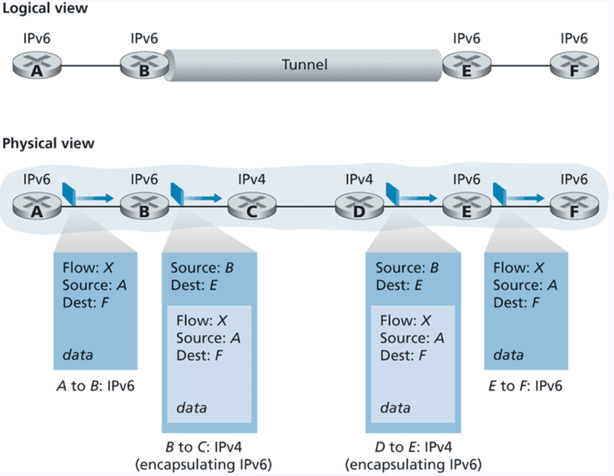
tl:dr
We wrap our IPv6 datagram in an IPv4 header, and pass it to the IPv4 router!

Slide 62
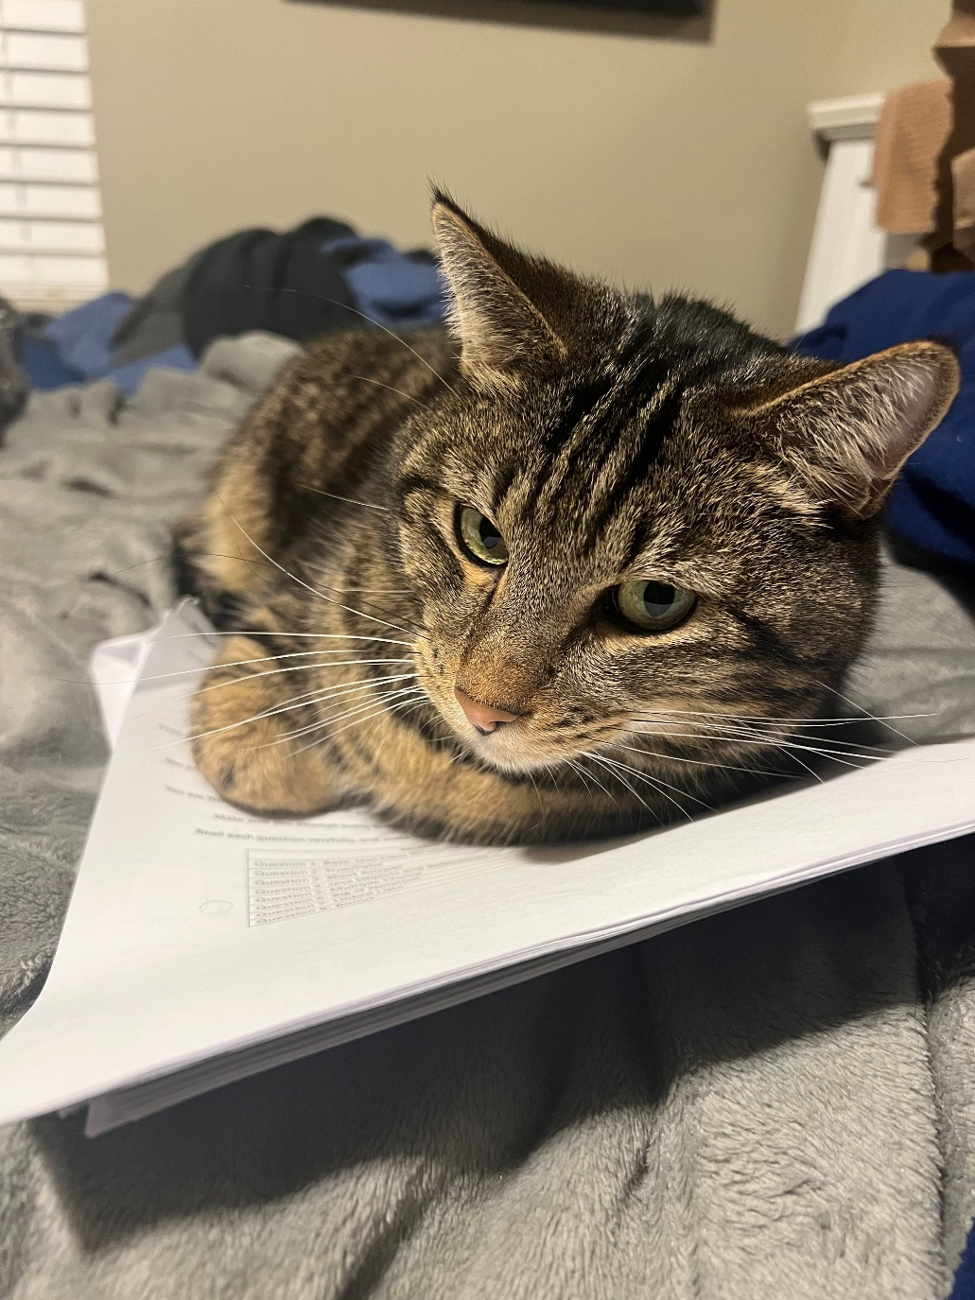

Slide 63
Generalized Forwarding and Software Defines Network (SDN)
So far, a router takes input from input port, and then outputs on some output port
What else might a router need to do?

Slide 64
Generalized Forwarding and Software Defines Network (SDN)
So far, a router takes input from input port, and then outputs on some output port
What else might a router need to do?
Forward, Drop stuff, Modify, Load balance
We need more flexibility and functionality with our forwarding!!

Slide 65
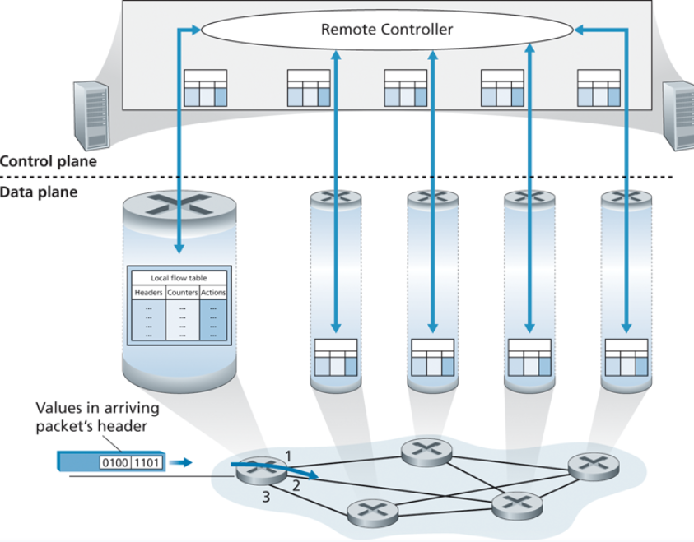
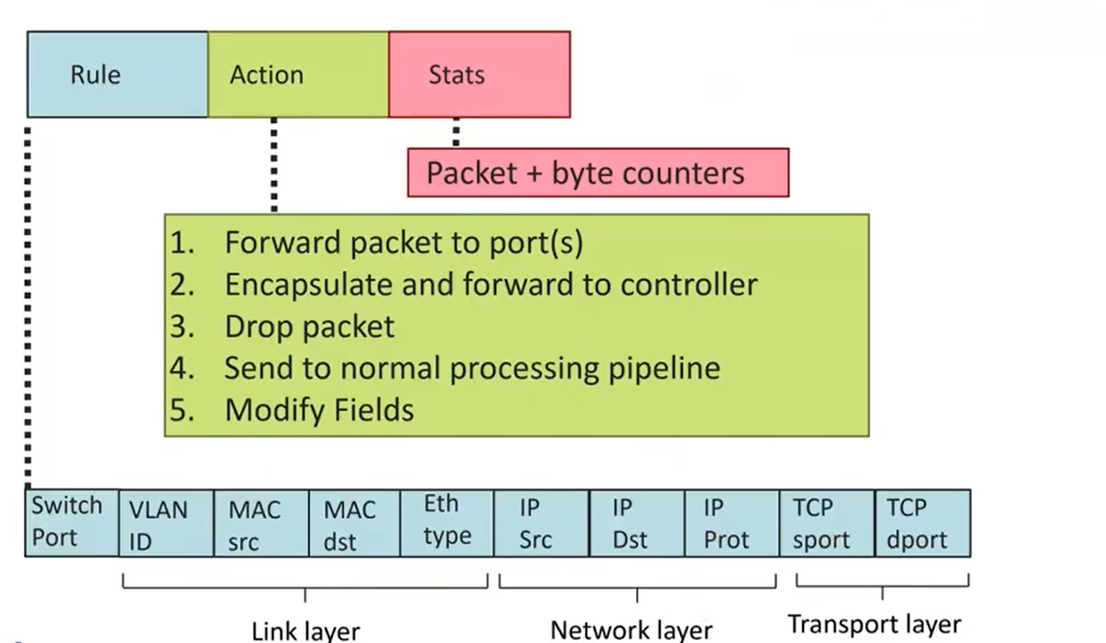
Generalized Forwarding and Software Defined Network (SDN)
OpenFlow standard
We need headers/rules, which are going to the values the remote controller is going to evaluate
We need actions to do based on some pattern match

Slide 66
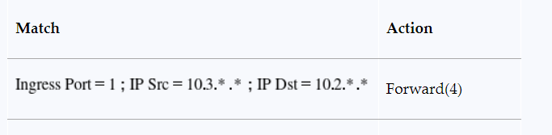
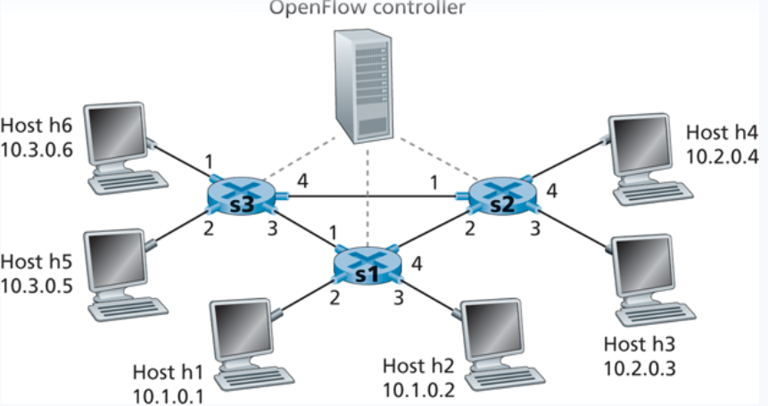
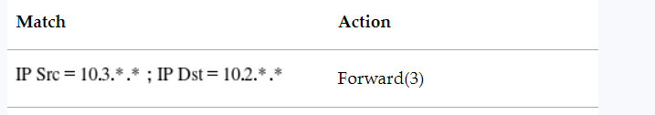
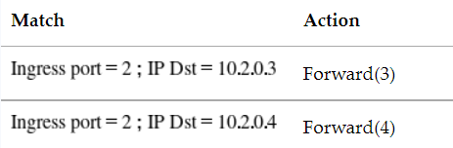




Generalized Forwarding and Software Defines Network (SDN)

Slide 67





Generalized Forwarding and Software Defines Network (SDN)

Slide 68
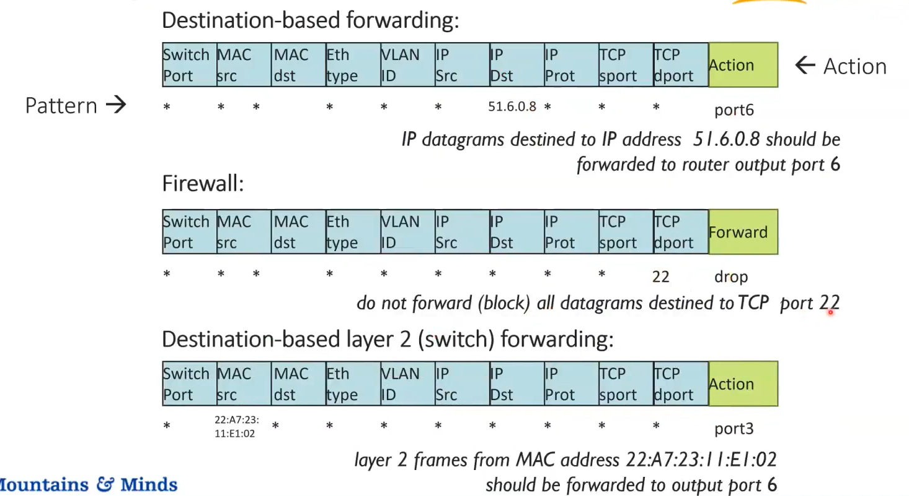
Generalized Forwarding and Software Defines Network (SDN)
22

